Slide 1

Project Title : “Online Admission Examination System”
Team Name : Poles of Power
Project Presented By
Md. Arif Hossen
UG02-50-19-005
Afrin Sultana
UG02-50-19-015
Sumaiya Rashmi
UG02-51-19-012
Course Code : CSE-0400
Course Title : Project Works

Slide 2
❑ Introduction
❑ Why is the online admission examination system important
methodology
❑ Projects tools
❑ Features
❑ Projects Details
-Data analysis
Advantages
Limitation
Team works
❑ Project Cost
❑ Gantt Chart
❑ Impacts on the environment
Future work
Problem face
❑ Conclusion
Contents

Slide 3
Introduction :
Beneficial for Education System.
Institution Can Host Online Examination
It will reduce the hectic job of assessing the answer script manually
It will allow the faculty to create test and answer key
It will reduce paperwork
Automatic grading and manual grading opportunity
Support of Online Result Publishing System
Update Version of Existing Examination System
Its more popular after Covid-19

Slide 4

Why is online admission examination system important?
It saves paper.
Save money .
It's more secure.
Quick Result Processing .
Readiness for Cases of Emergency during Exams .
It saves time.
ensure 100% attendance .
Space reduce .
Traffic jams reduce.

Slide 5
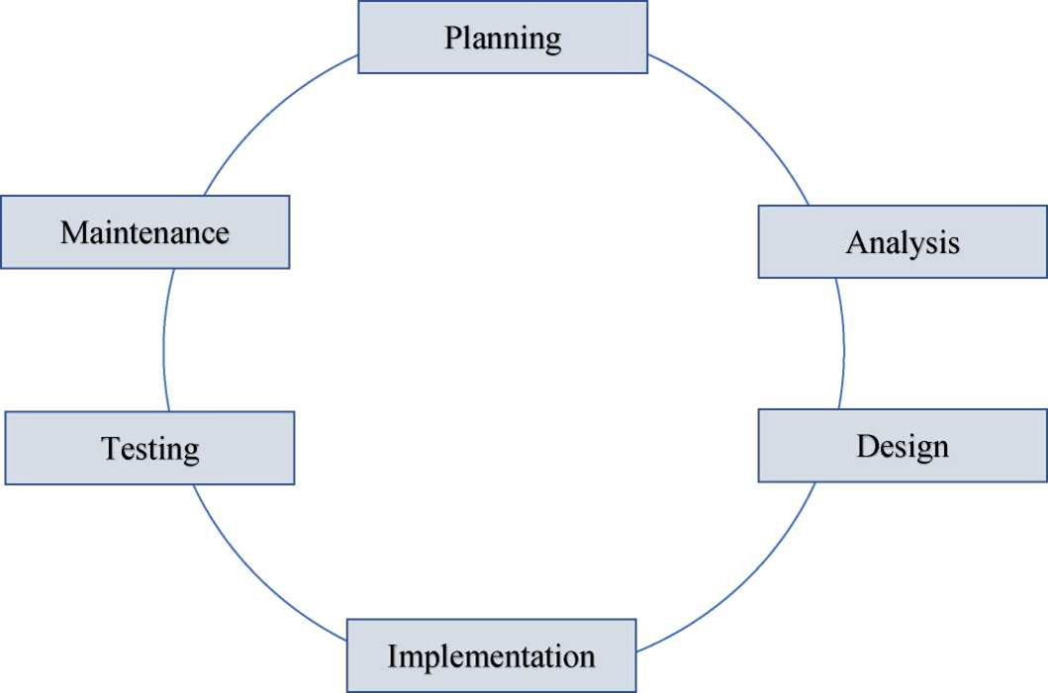
Methodology
To develop this project, we have to follow some methodology. Those methodology mentioned below:

Slide 6

Project tools-
▪ Front end
✔ Java
✔ Android
▪ Back end
✔ Java
Database
Firebase

Slide 7

Feature:
Create Account .
login .
Verifying password.
Online Question .
Automation of planning and schedule.
Efficiency to create a question bank .
Use Rich Text and image.
Main Features
Exam Scheduling and Planning
Configuring different type of questions
Instant Result Evaluation
Result Analysis and Dashboards
Important alerts

Slide 8
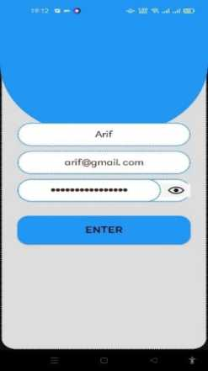
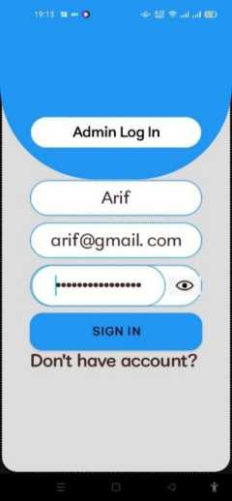
Project Details
Fig : Admin Sign Up
Fig Admin Log in

Slide 9
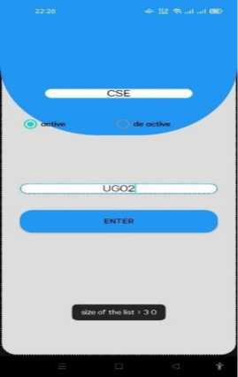
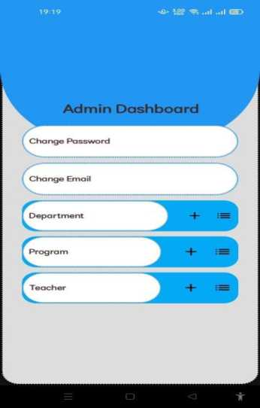
Project Details
Fig : Admin Dashboard
Fig : Add Department

Slide 10
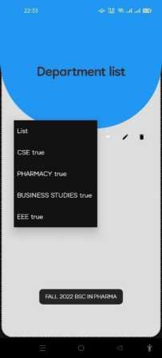
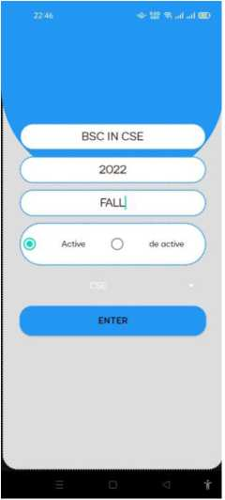
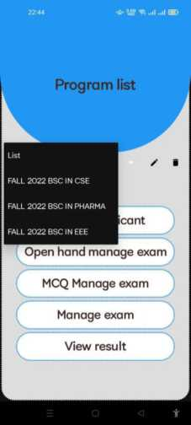
Fig Manage Program
Fig Manage Department
Fig Add Program

Slide 11
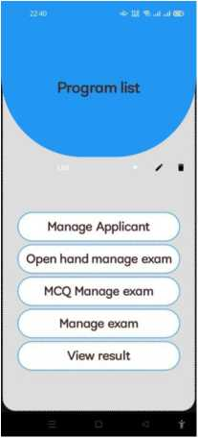
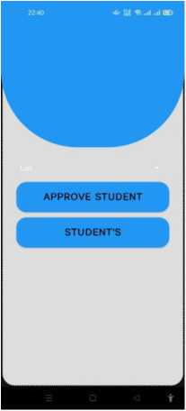
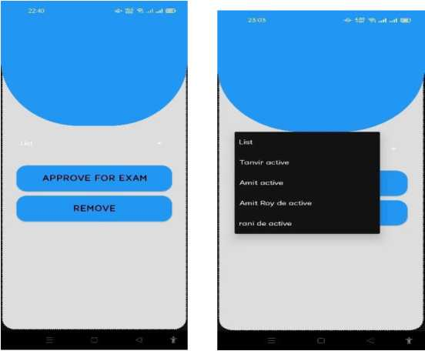
Fig : Manage applicant

Slide 12
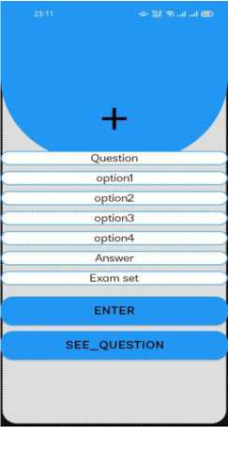
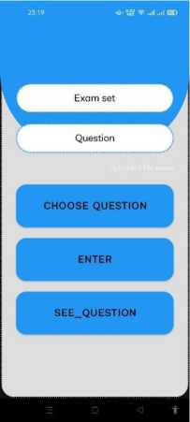
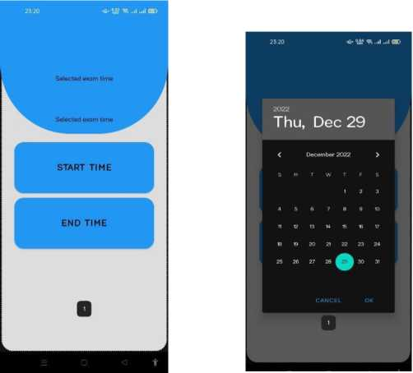
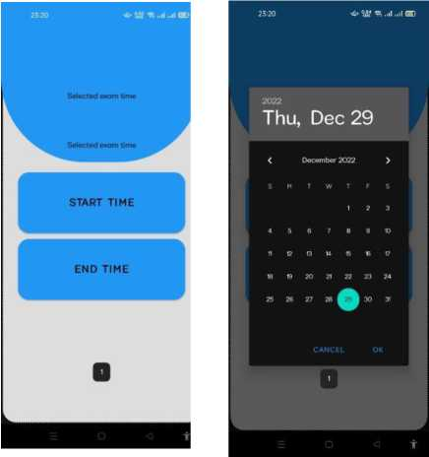
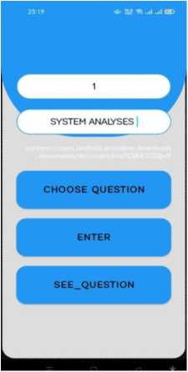
Fig : Manage Mcq Exam
Fig: Manage Open Hand

Slide 13
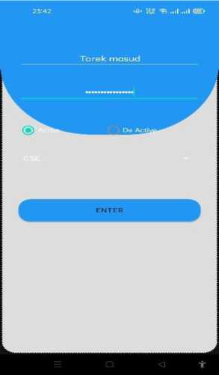

Fig : Manage teacher

Slide 14

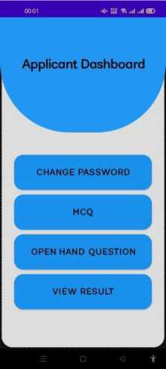
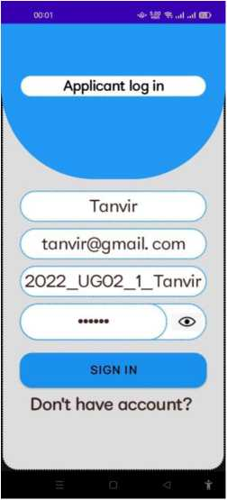
Fig Applicant gets permission for login
Fig Applicant Dashboard
Fig Applicant login
Manage Applicant

Slide 15
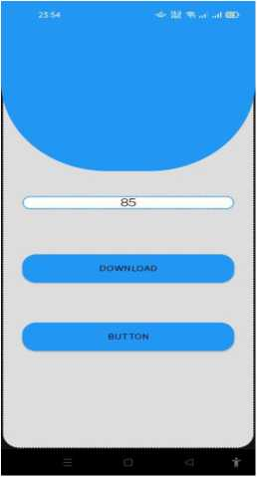
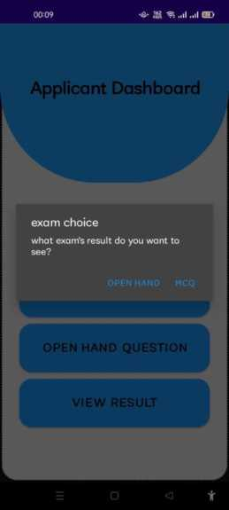
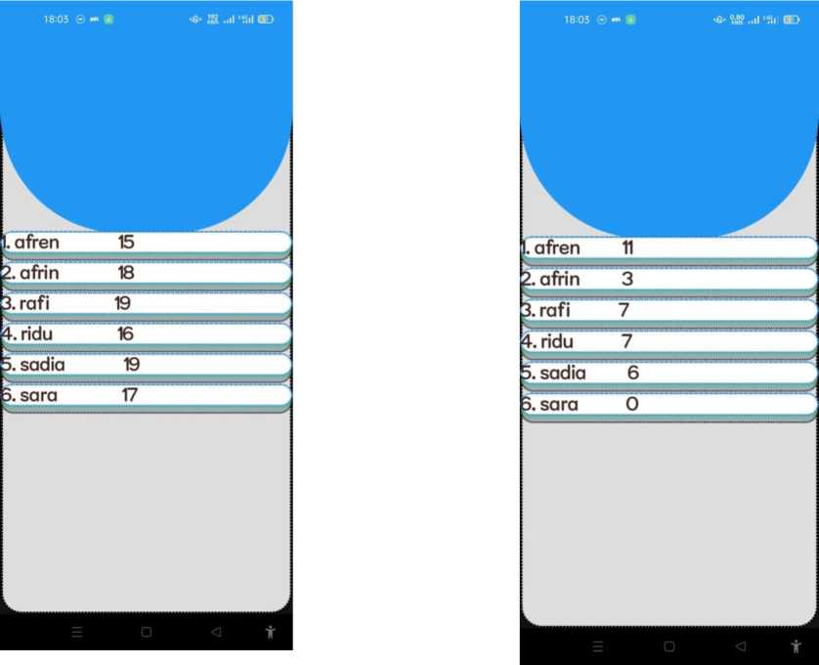
Teacher submit mark
Mcq /Open hand marks
Open hand mark
Mcq mark
Manage exam

Slide 16
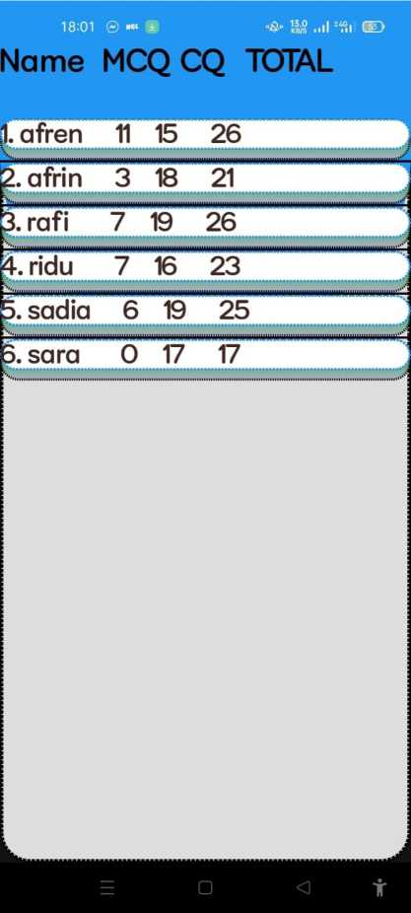
Final output

Slide 17
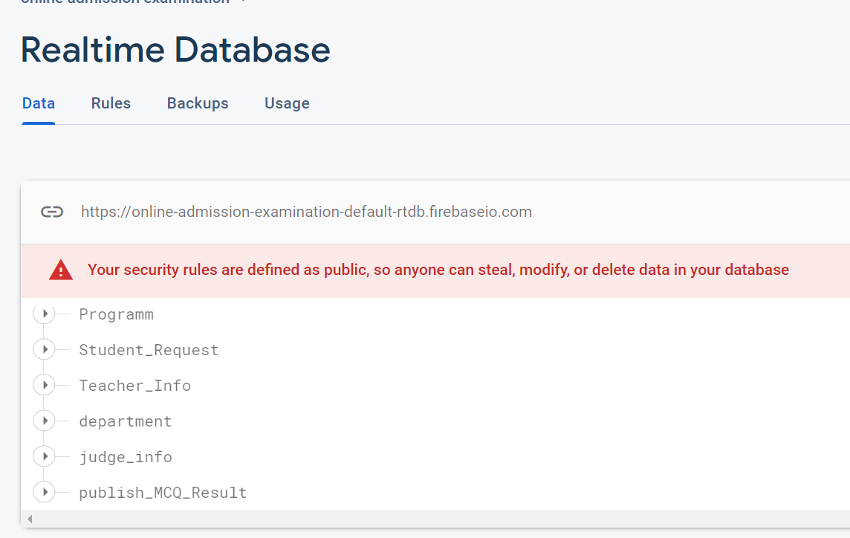
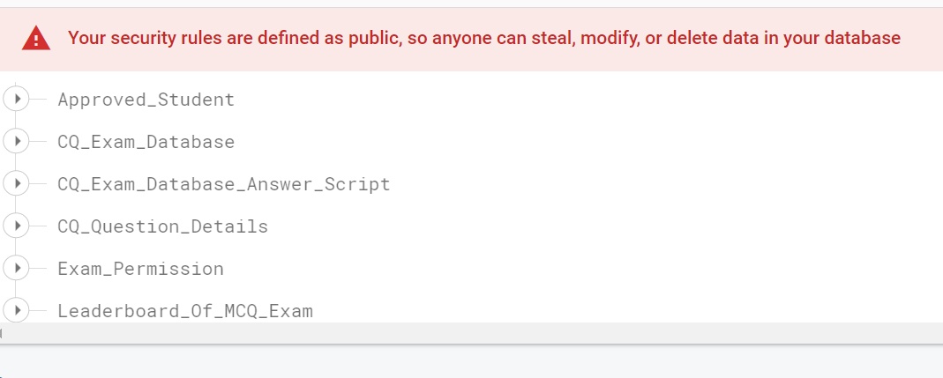
Data analysis

Slide 18

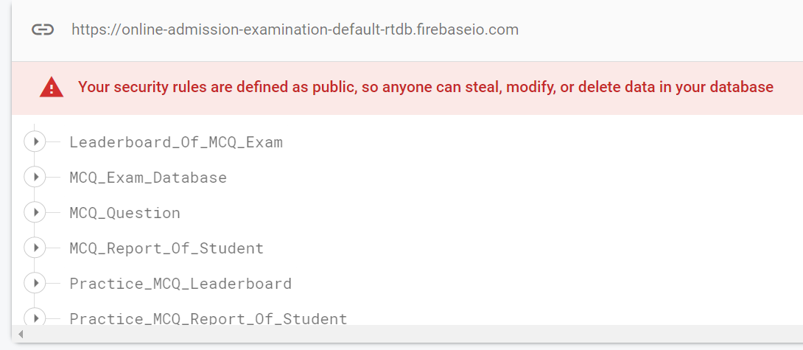

Slide 19

Advantages:
Convenience of administration
Cost effectiveness
Less time consuming
Paper checking and result generation
Screen Recording during online exam
Limitation:
No audio and video recording options
Copy and cheating
Applicant activity log access

Slide 20
Team works:
Team Member | Working Hour(Week)
Arif Hossen | 12-14
Afrin Sultana | 12-14
Sumaiya Rashmi | 12-14
So, we was use 7 to 8 months for development and 1 month for testing purposes.

Slide 21
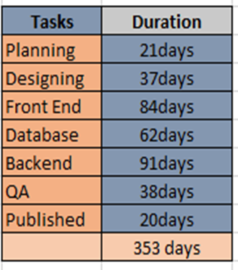
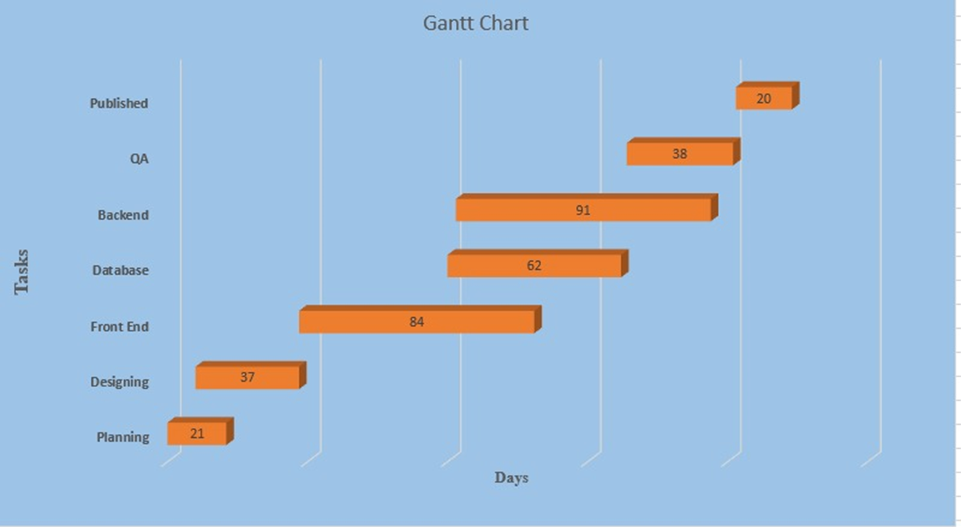
Gantt chart

Slide 22

Impacts of environment and society
Minimize the amount of paper work
Economical
Saves money
Saves time

Slide 23

Future work
We can implement to give the exam by keeping the video open so that they cannot cheat. API problem solve so that it is possible to execute on apple or any android.

Slide 24

Problem Face
Firebase data limitation
Android API problem

Slide 25
Conclusion
This system will save the time of teachers and students, will help to continue institutional test process at any pandemic situations. For also the institutions, because every faculty, department, every part of the institution exam record can be recorded there, so anybody can easily get their record history. Setting up exam questions and students seeing their result graph curve, time management, all of this concludes the online examination system as the major part of any educational institution.

Slide 26


